Slide 2

Early Breast Cancer Detection: A Data Mining Approach
CSE 572: Data Mining
Prof. Yanjie Fu
Amit Ashok Manjarly
Aditya Deshpande

Slide 3
01
Introduction
02
Initial EDA
Table of Contents
03
Data Pre-processing
04
Initial Model Training
05
Check point 2
06
Conclusion and Future Plan

Slide 4
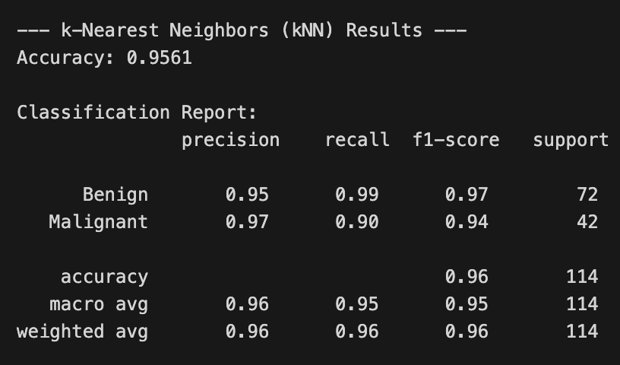
01 Introduction
Initial Dataset: The Wisconsin Diagnostic Breast Cancer (WDBC)
WDBC Overview
A well-known, clean dataset initially considered for its simplicity; it serves as good starting point for breast cancer detection modeling.
The "Good Problem": Overly Clean Data
High accuracy (95-97%) with baseline models due to the data's inherent simplicity; challenges the project's learning objectives.

Slide 5
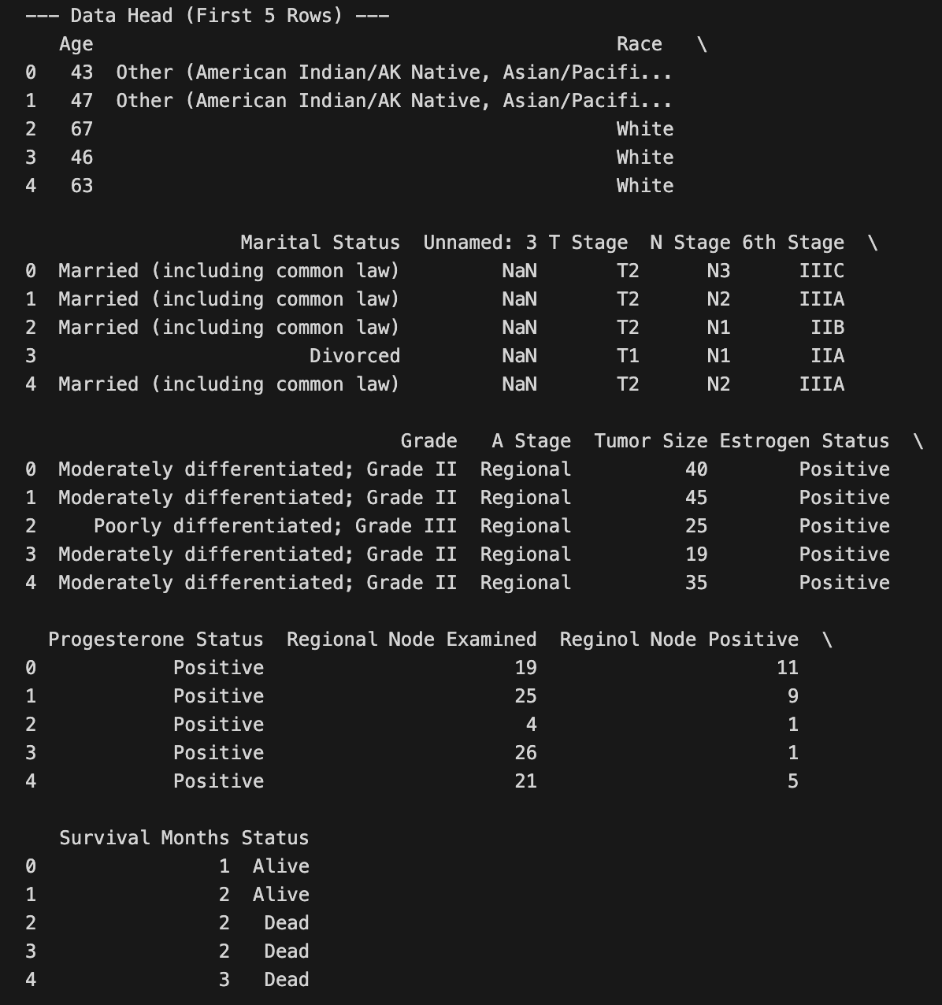
The Solution: Surveillance, Epidemiology, and End Results (SEER) Dataset
01
SEER Overview
A larger, more complex dataset providing real-world challenges; SEER offers a mix of numerical and categorical data.
02
Real-World Data Mining Challenges
Missing values, class imbalance, and complex data types offer opportunities; SEER offers a better representation of reality for modeling.

Slide 6
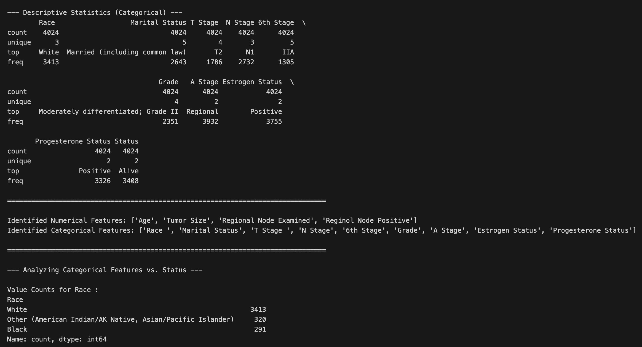
02 Initial EDA
Initial Data Inspection
Dataset Size and Structure
Over 4,000 patient records with 16 columns; SEER offers the appropriate scope and scale for meaningful modeling.
Data Types
Mix of int64 (numerical) and object (categorical) data types; requires careful preprocessing to prepare for analysis.

Slide 7
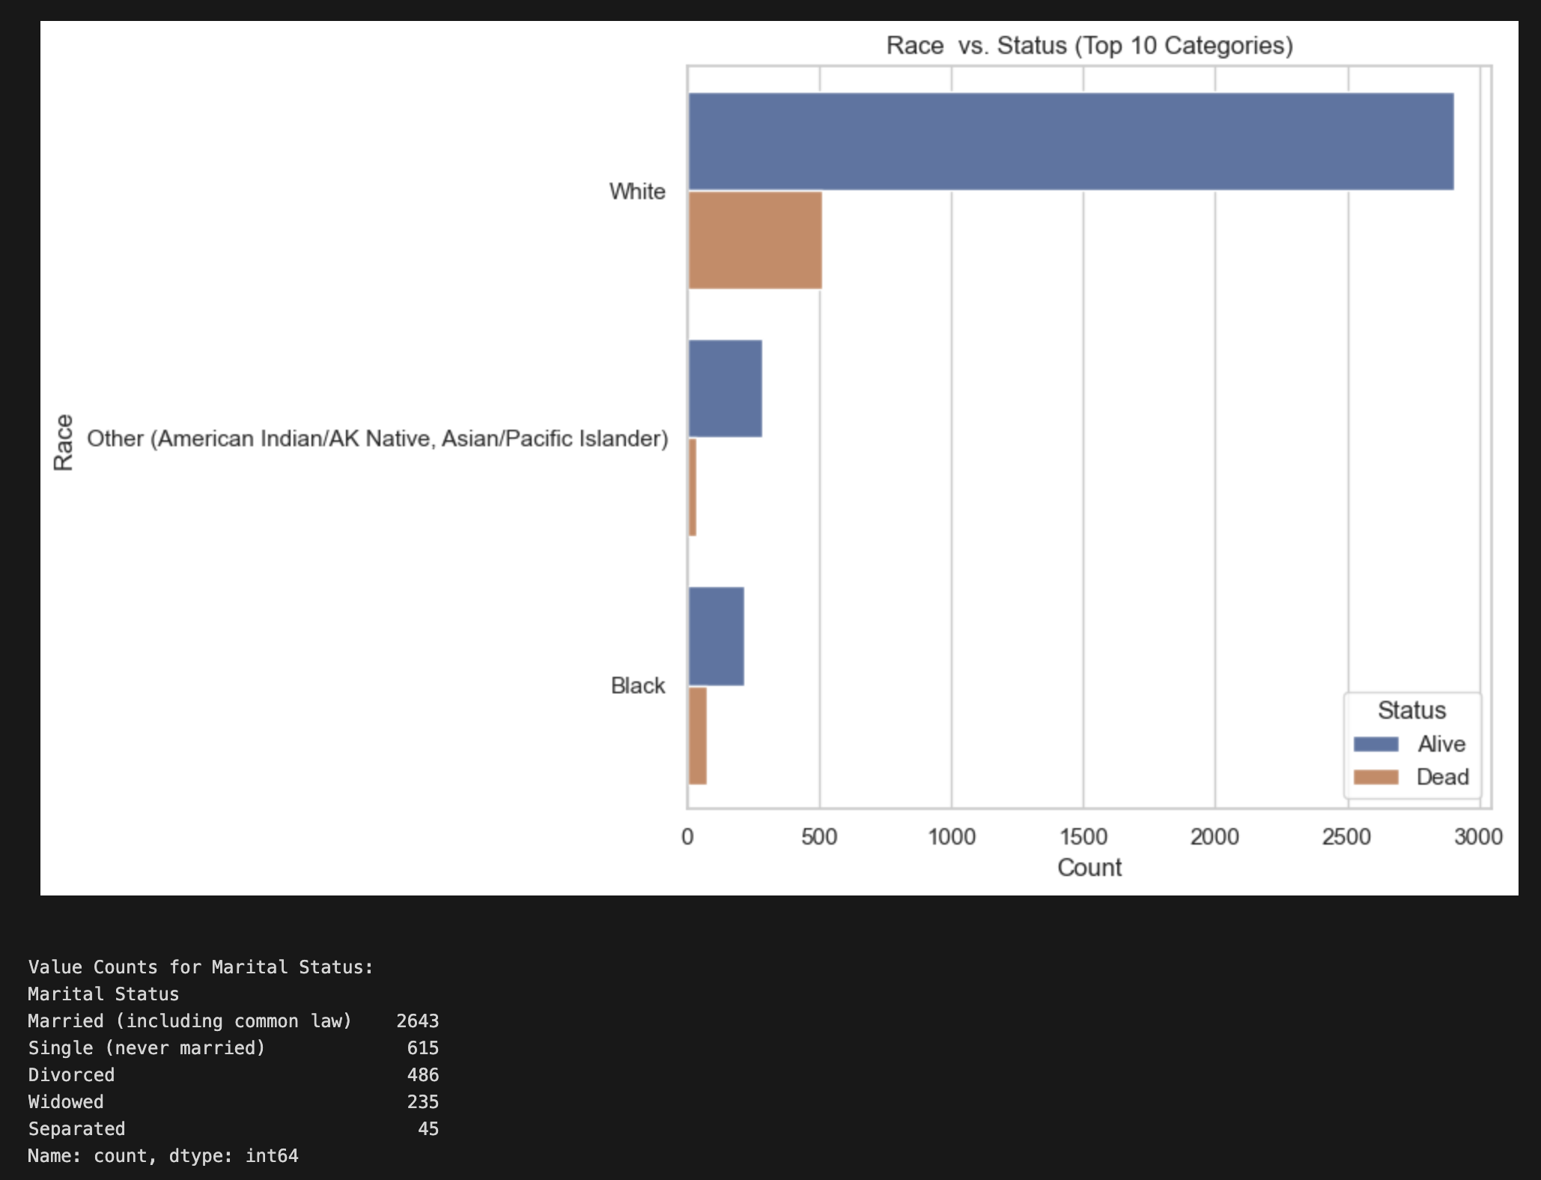
Target Variable Analysis: Status
Distribution of "Alive" vs. "Dead"
Significant class imbalance: 85% "Alive," 15% "Dead"; reveals challenges the modeling must overcome.
Implications of Class Imbalance
Accuracy as a misleading metric; emphasizes the need to correctly identify the minority class "Dead."

Slide 8
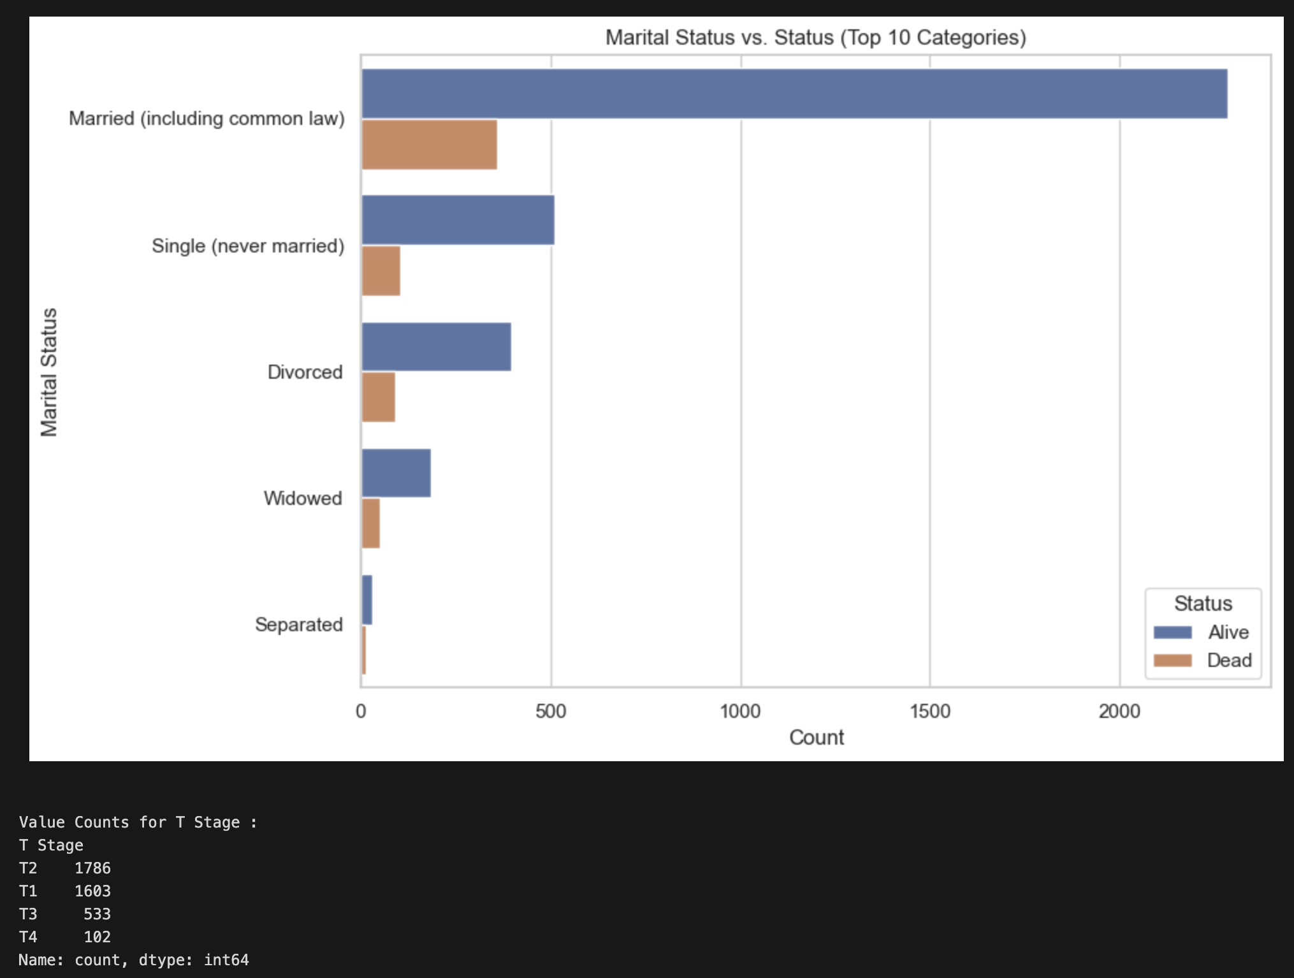
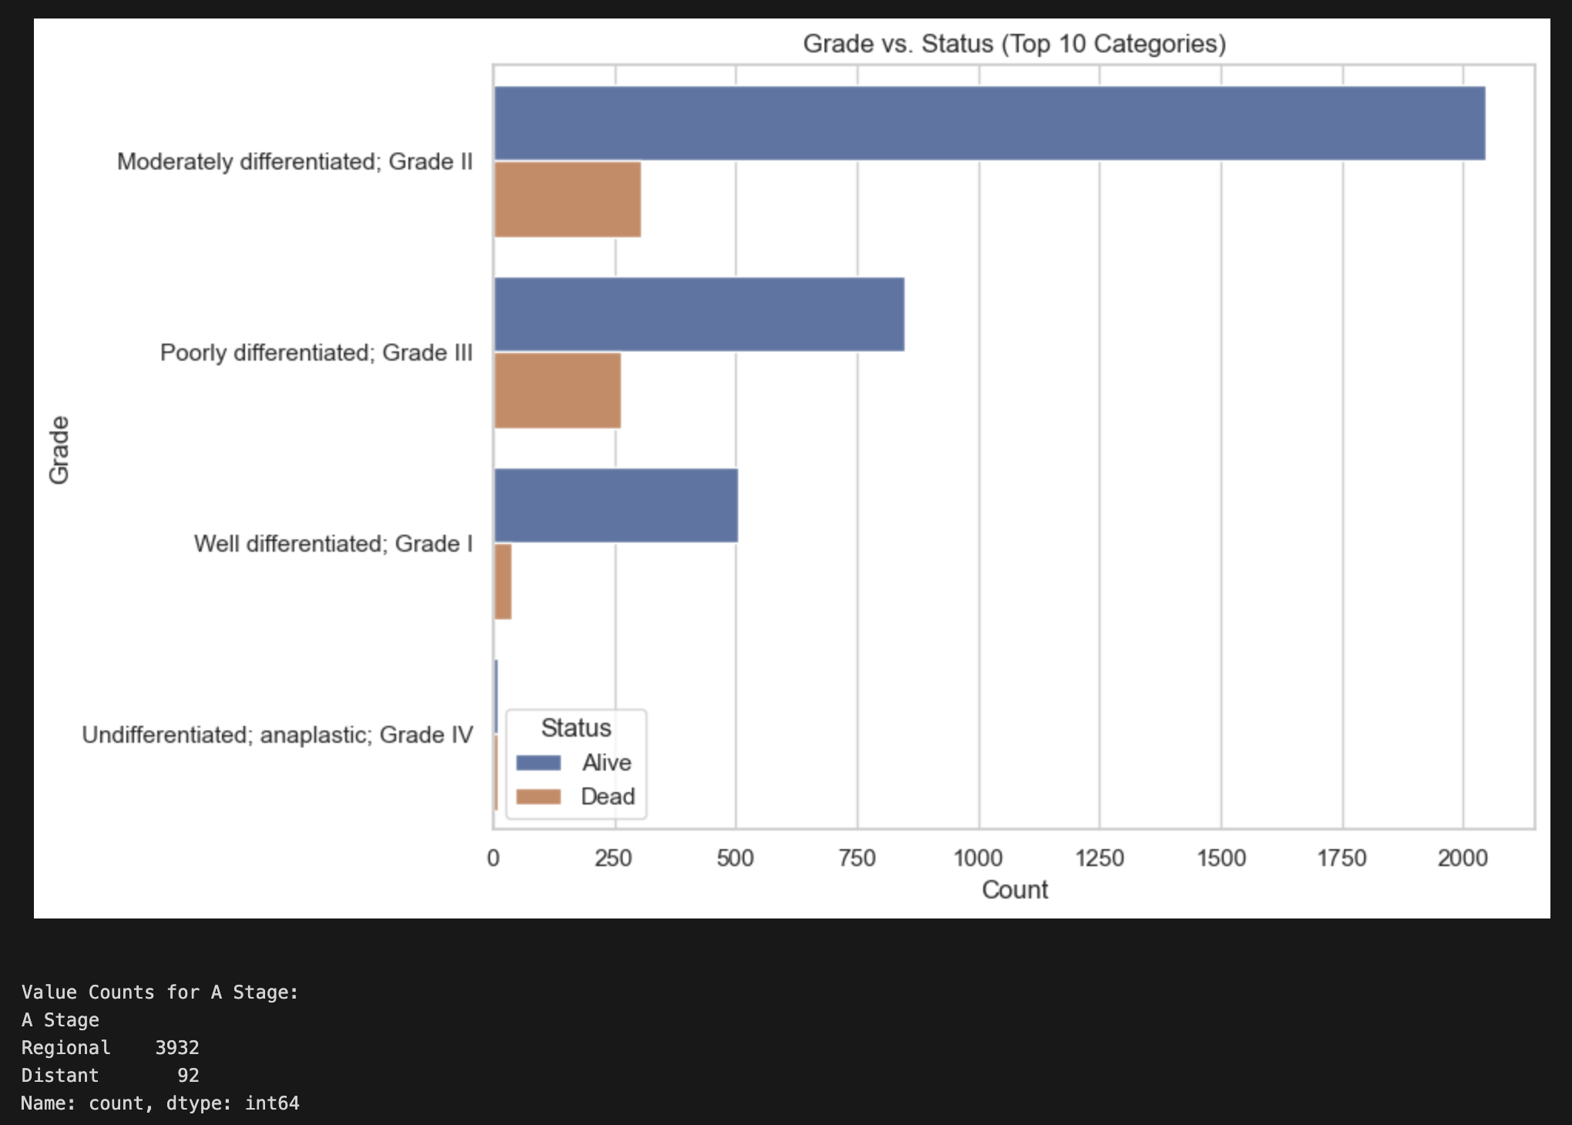
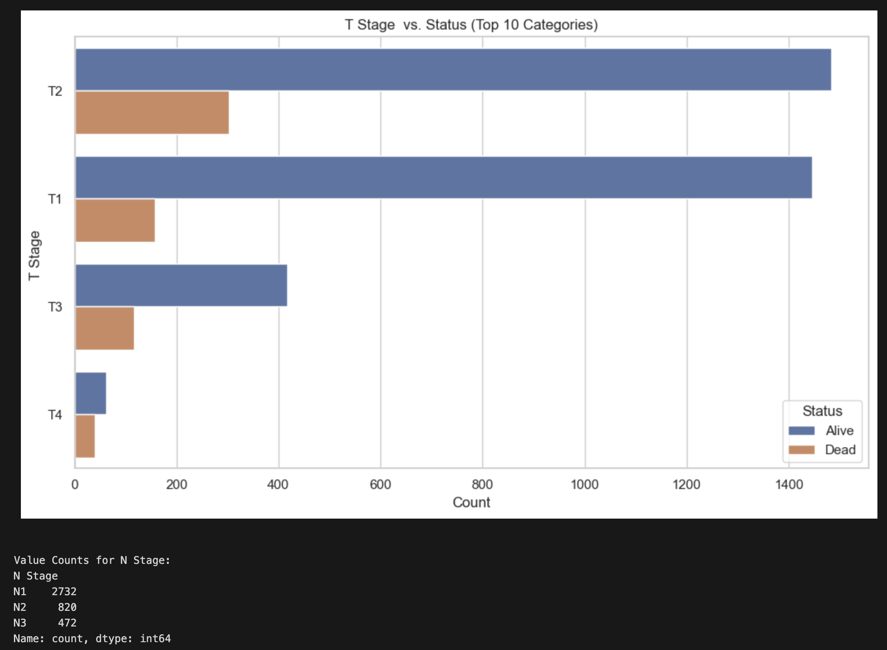
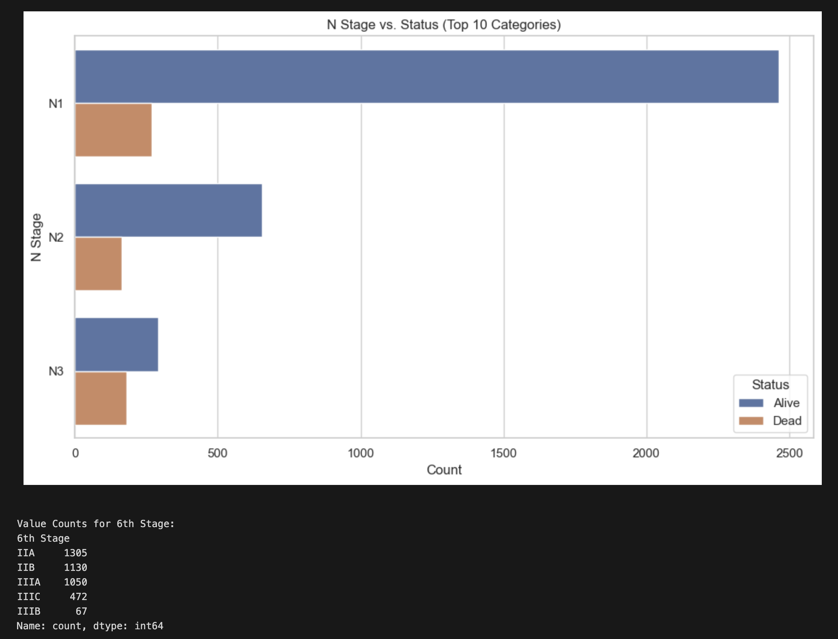
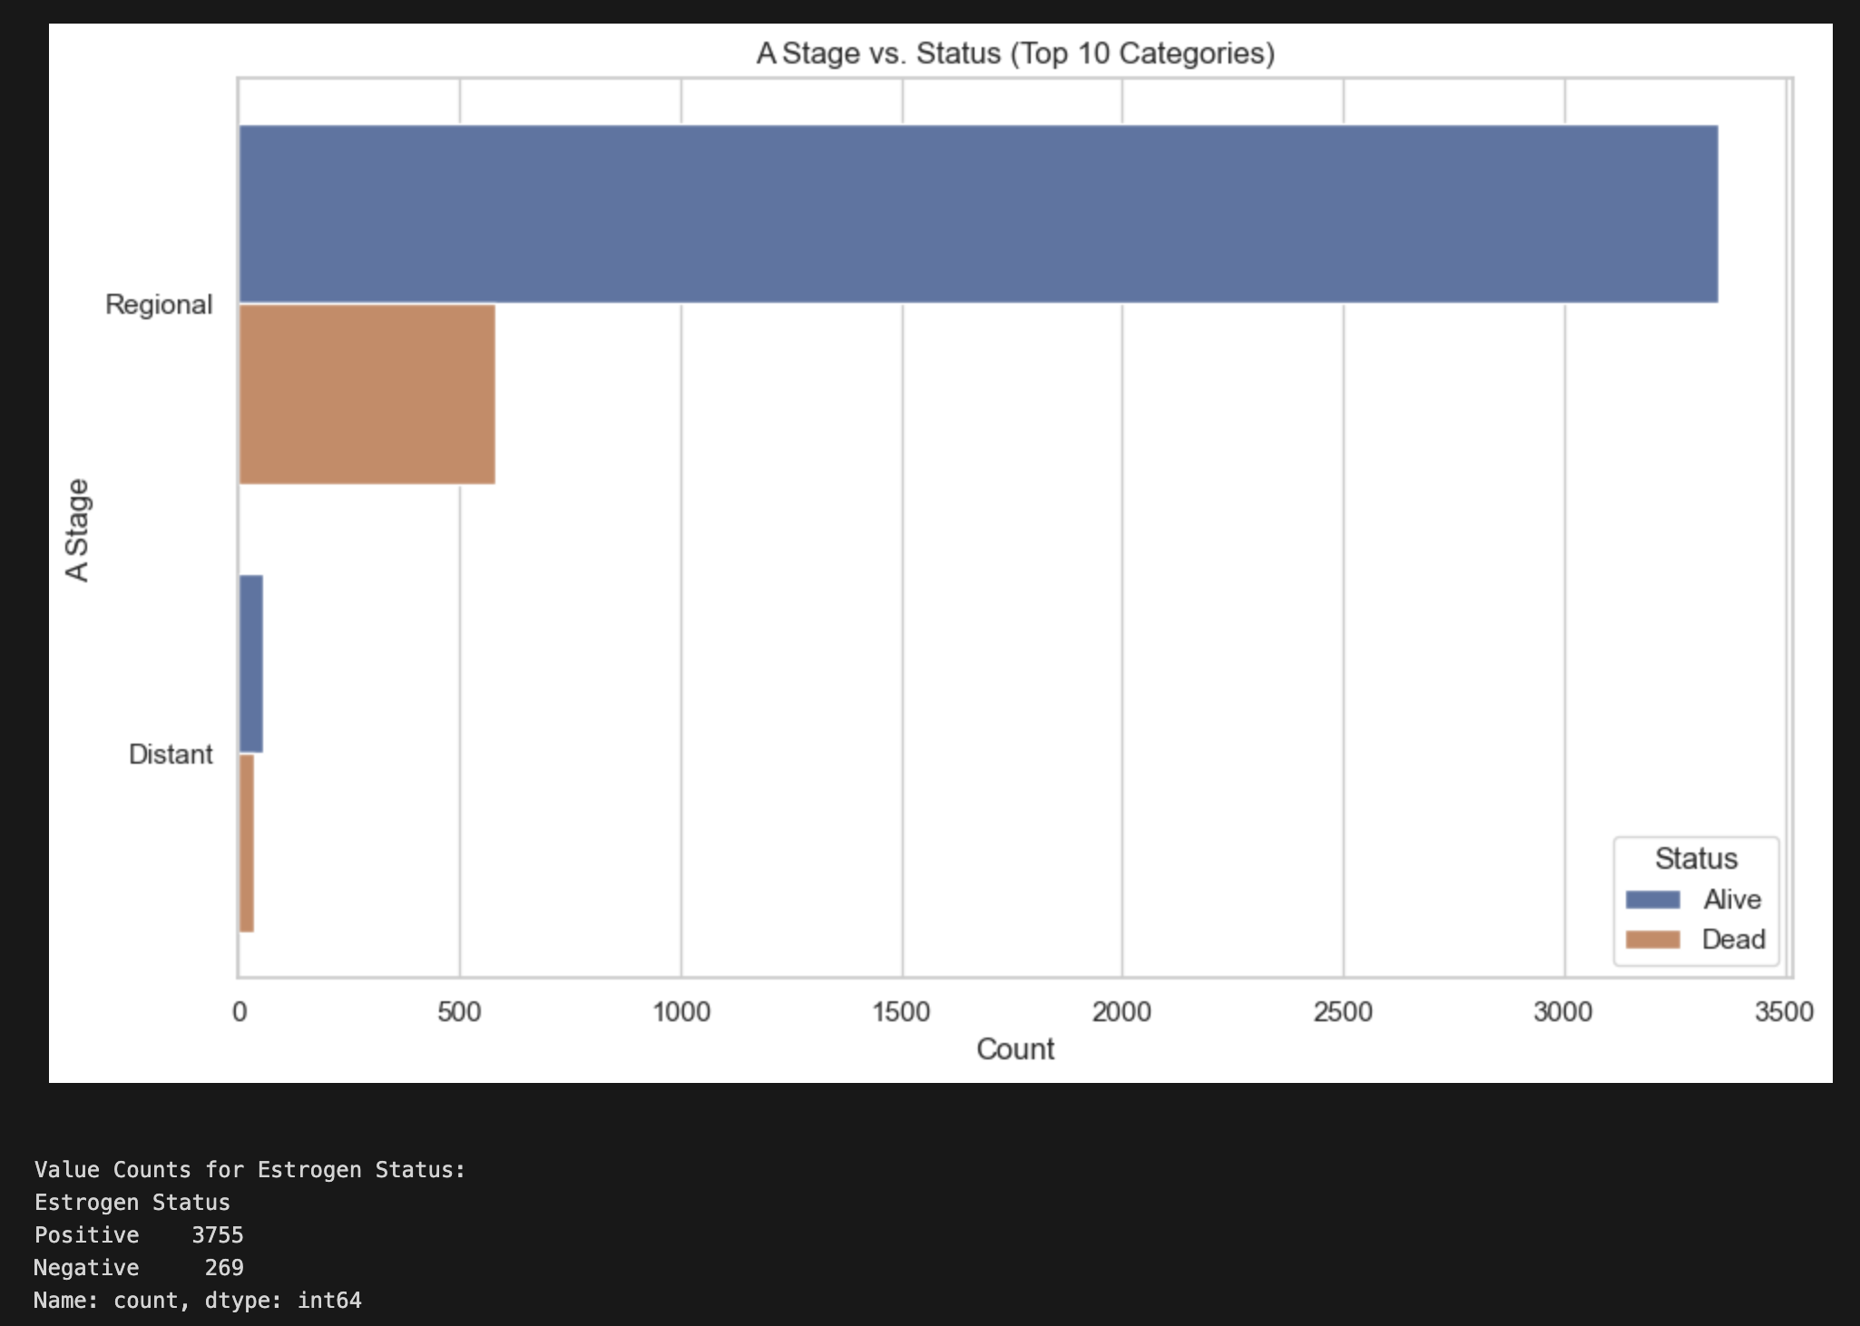
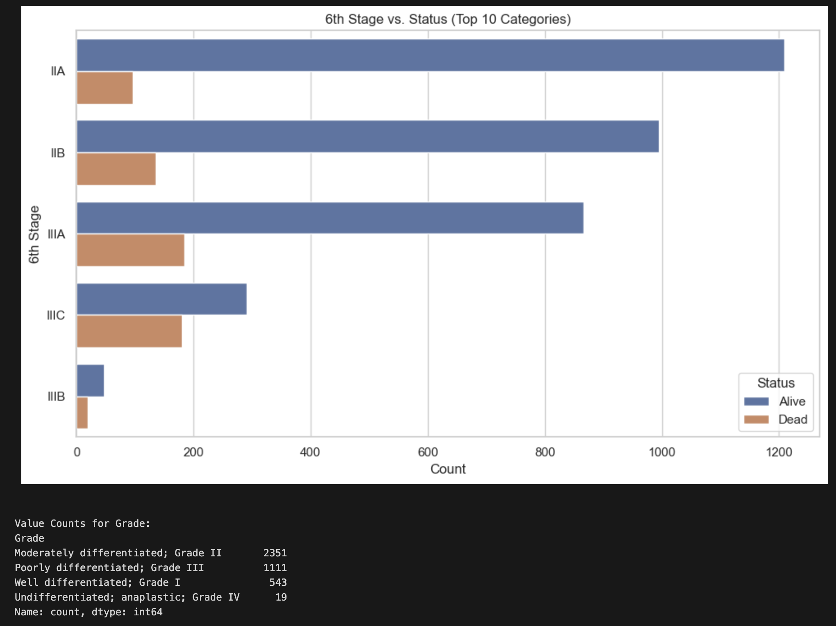
”Alive” vs “Dead” Comparison

Slide 9
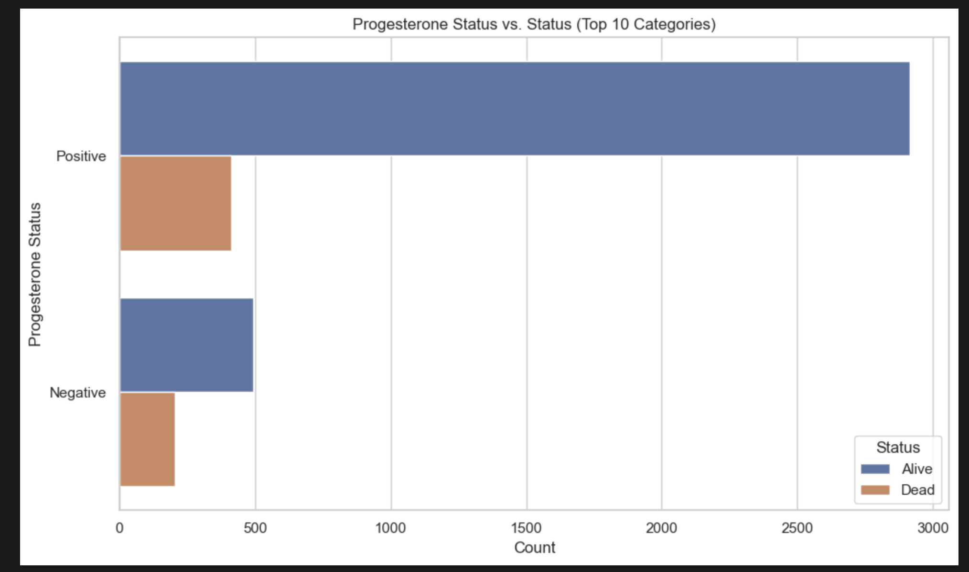
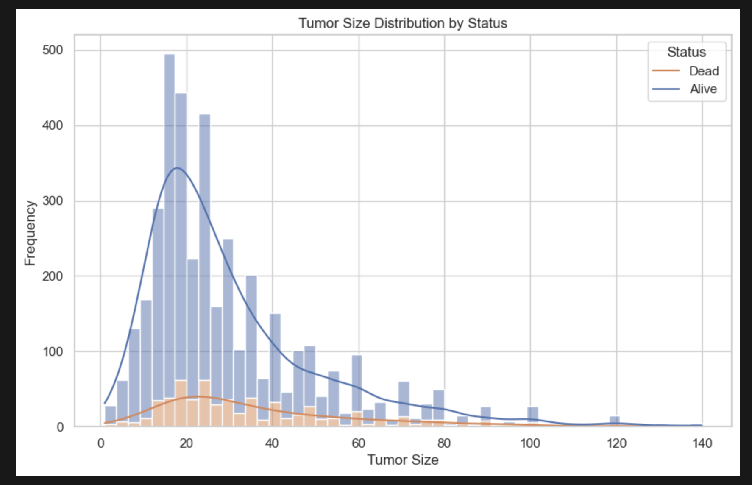
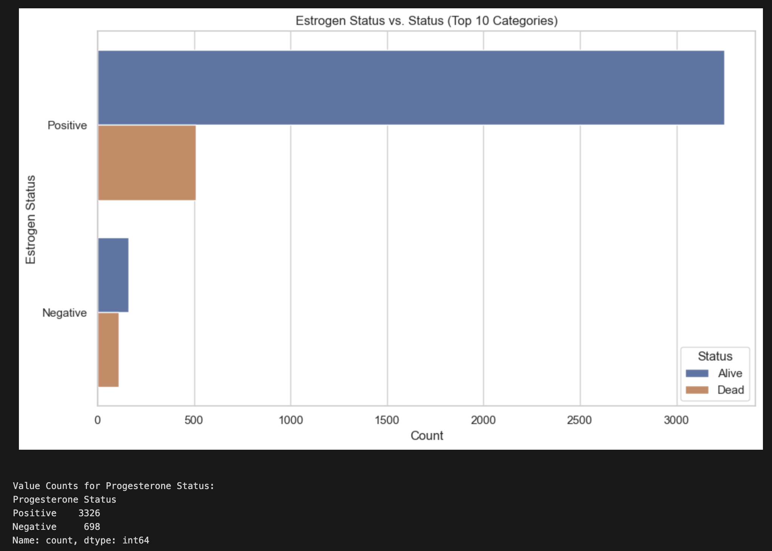
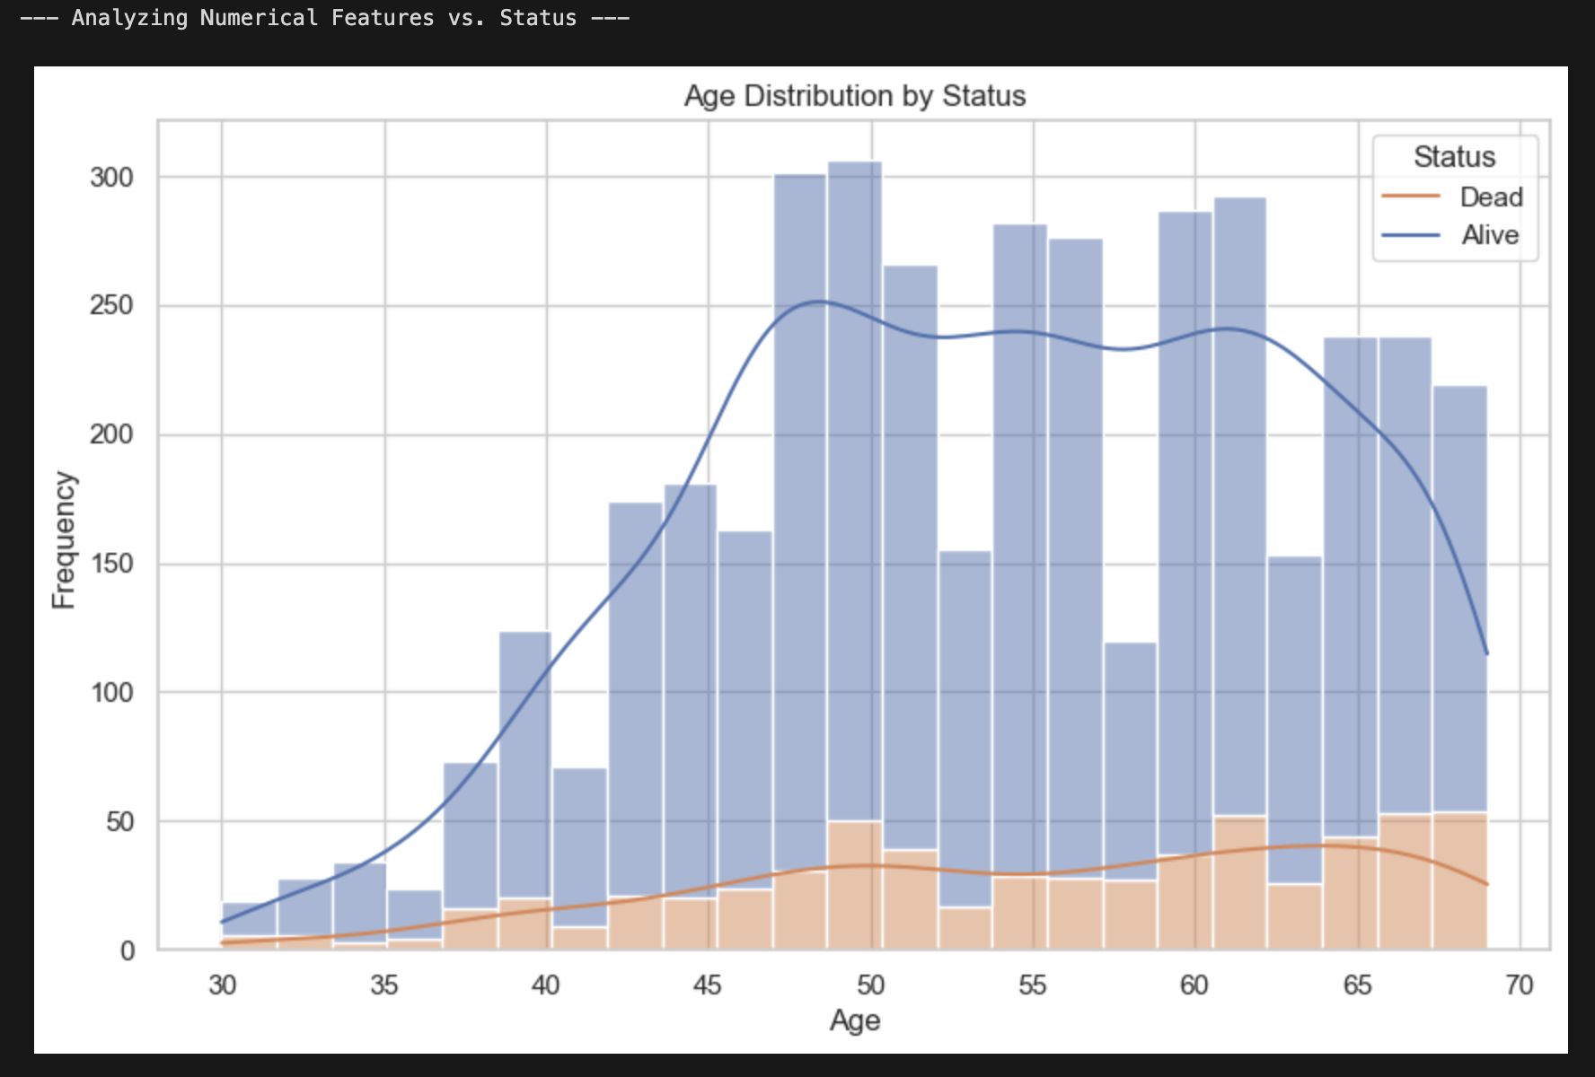
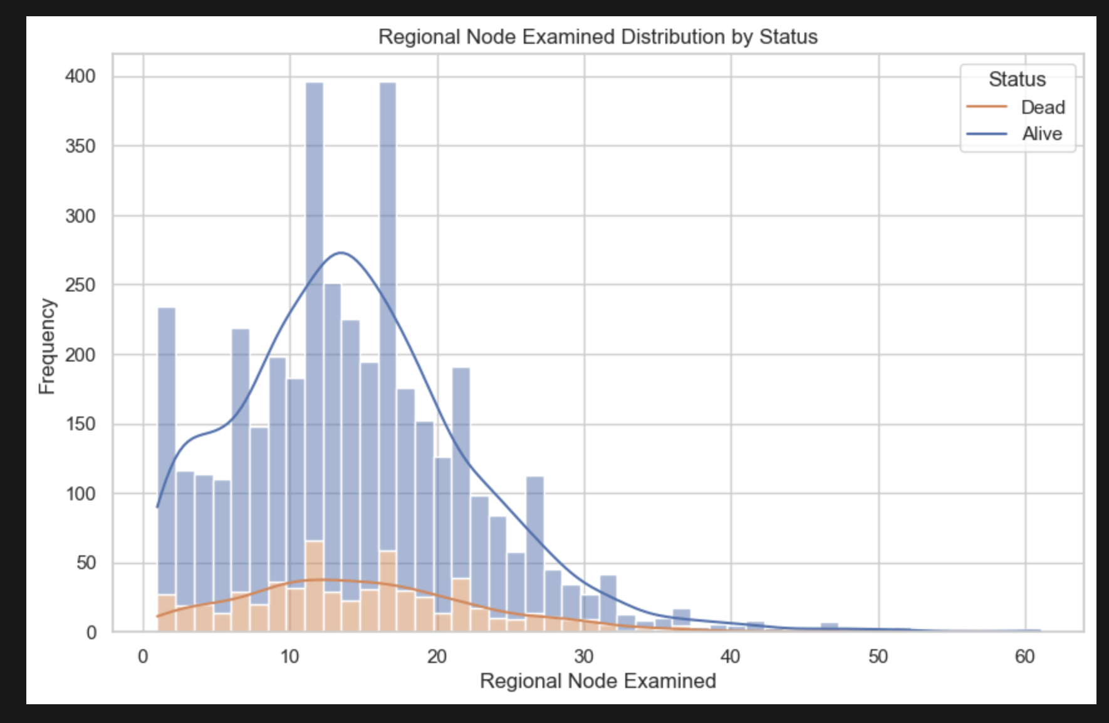
”Alive” vs “Dead” Comparison

Slide 10
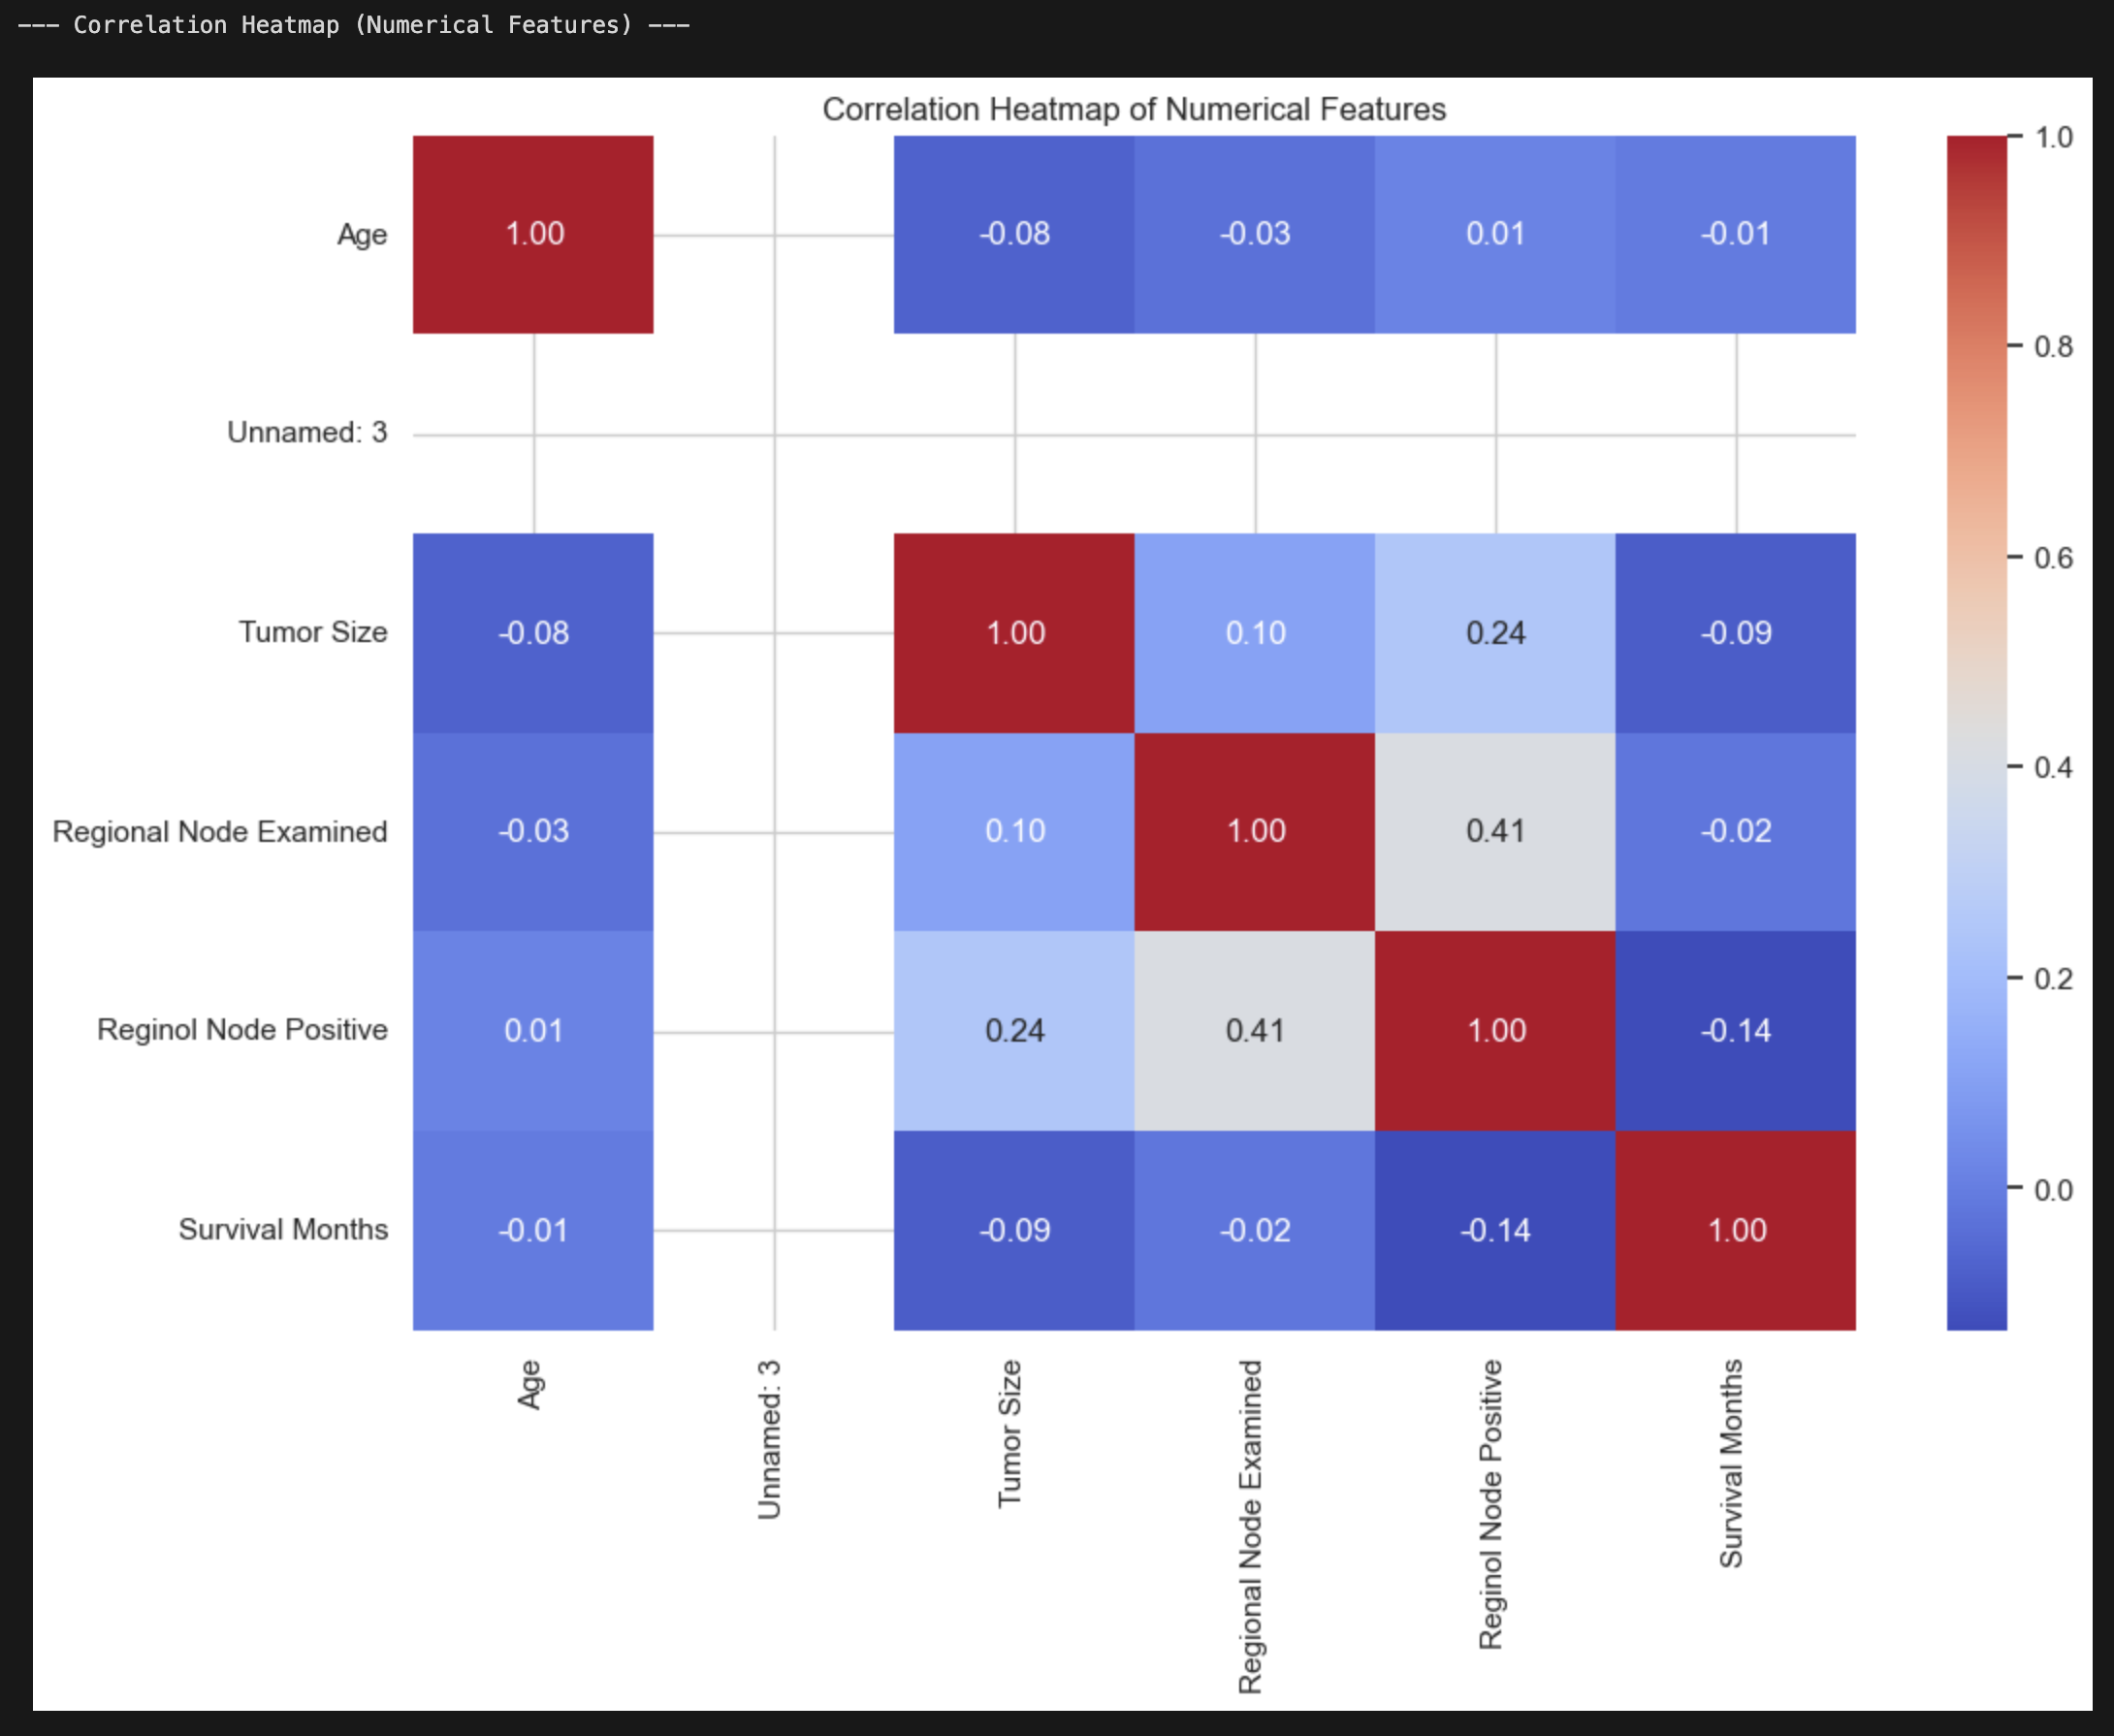
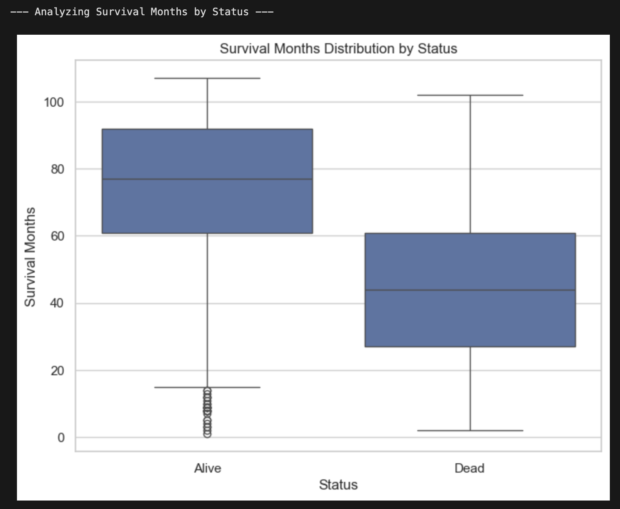

Slide 11
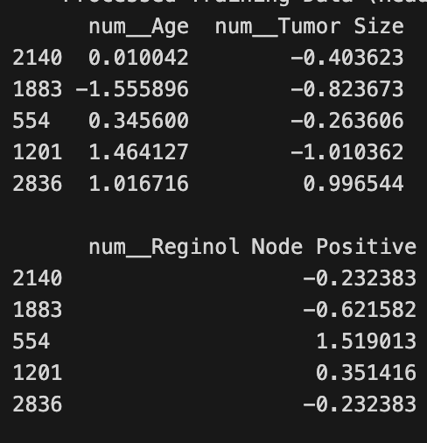
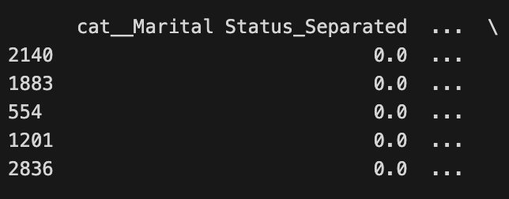
Categorical Feature Analysis
01
Insights from Categorical Features
02
Predictive Value of Categorical Data
"Marital Status," "T Stage," and "N Stage" show varying proportions of "Alive" vs. "Dead"; categorical variables are of particular interest as they possess real predictive value.
Confirms the importance of including these features in the predictive model; inclusion assists with overall model performance.

Slide 12
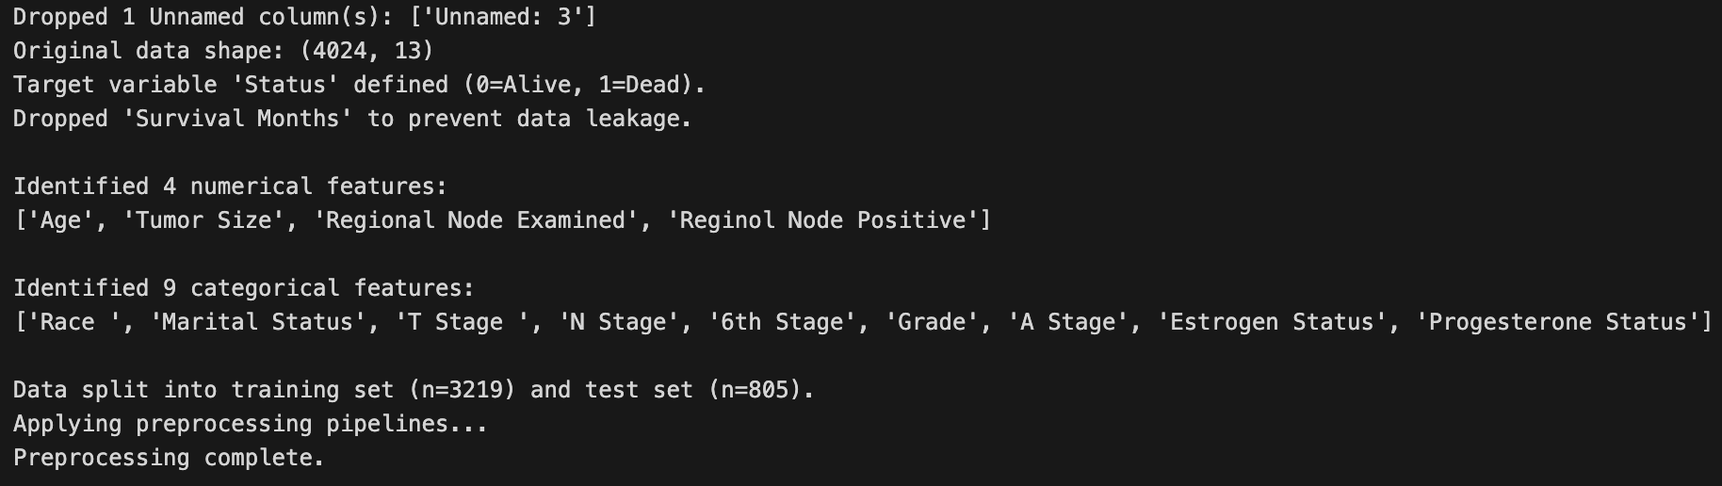
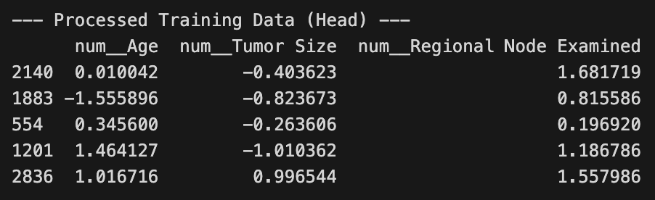
03 Data Preprocessing
The Preprocessing Strategy
Goal of the Pipeline
To create a single, automated, and robust process; address missing values, different data types, and scaling issues.
Tools and Techniques
Using scikit-learn's ColumnTransformer and Pipeline objects; ColumnTransformer and Pipeline prevent data leakage.

Slide 13
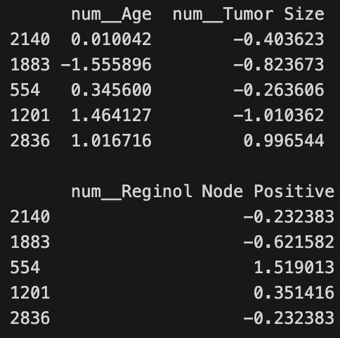
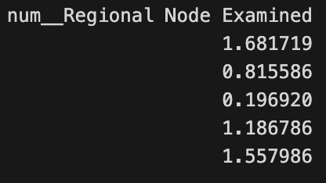
Parallel Pipelines
Numerical Data Pipeline
Imputation of missing values using the median; imputation is chosen over mean because the median is more robust with outlier removal.
Scaling with StandardScaler
Scaling all features using StandardScaler; ensures features like "Age" don't overpower features like "Tumor Size."

Slide 14
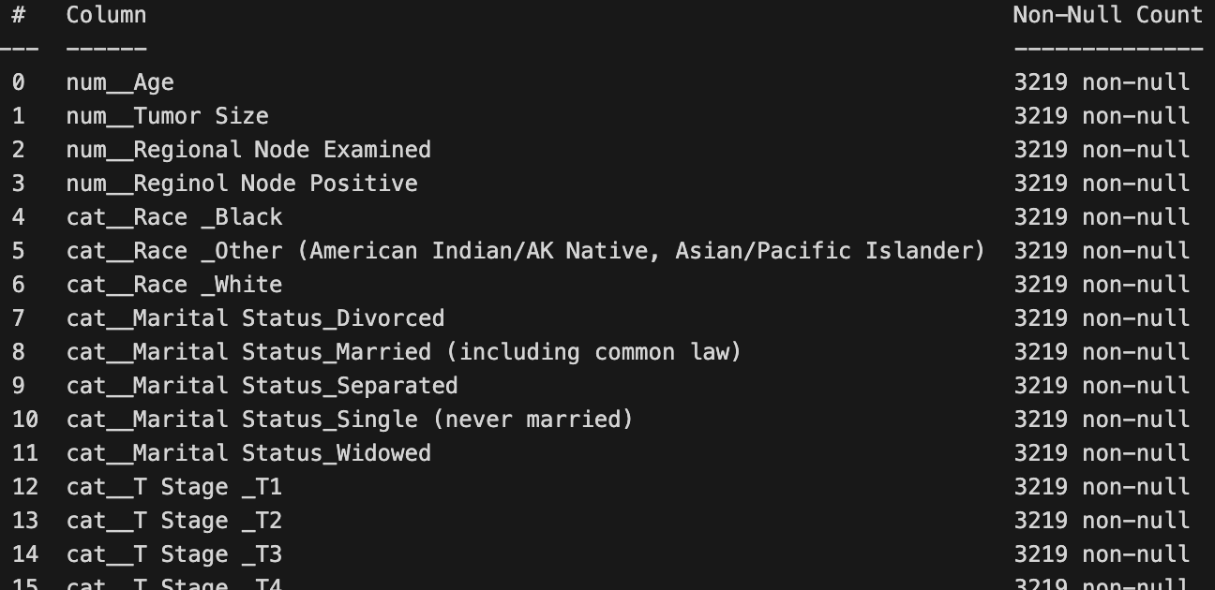
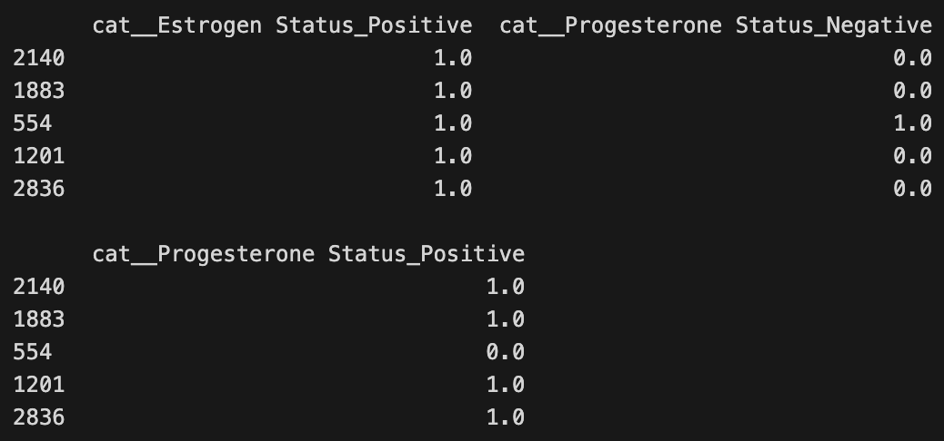
Categorical Data Pipeline
One-Hot Encoding
Imputation of Missing Categories
Converting text into a binary vector; prevents the model from incorrectly learning relationships between categories such as “Married” and “Single.”
Imputation using the mode (most frequent value); ensures that missing values do not influence outcomes.

Slide 15
Final Processed Data & Handoff
01
02
03
Train-Test Split
Ensuring No Data Leakage
Results of Preprocessing
Performing train-test split before any preprocessing; fitting preprocessor on training data only.
Using the transform method on the test set; avoiding information leakage or statistical bias from the test set leaking into the training process.
Clean, entirely numerical data, expanded from 16 features to over 40; data is now ready for model building and evaluation.

Slide 16
04 Initial Model Training
Initial Model Results - The Challenge
Trained 7 baseline models (Logistic Regression, k-NN, SVM, Naive Bayes, Decision Tree, random forest, and AdaBoost)
Dataset: 4,024 samples, 13 features (34 after one-hot encoding)
Performance Summary:
  Accuracy: 77-85% (high)
  Recall (Dead class): Only 11-15% (very low)
  Problem identified: Class Imbalance
    Alive: ~84% vs Dead: ~16% (5.5:1 ratio)
Key insight: High accuracy is misleading—models predict everyone as "Alive" to get 85% accuracy, which is useless for identifying at-risk patients.

Slide 17
Model Improvement Strategy
Three Experiments:
Baseline Models: 4 key models (Logistic Regression, Random Forest, AdaBoost, SVM)
  Purpose: Establish baseline for comparison
Hyperparameter Tuning (Random Forest):
  GridSearchCV with 3-fold cross-validation
  Tuned: n_estimators, max_depth, min_samples_leaf
  Key: Added class_weight='balanced' to address imbalance
Stacking Classifier:
  Ensemble: Tuned RF + AdaBoost + Balanced SVM
  Meta-learner: Logistic Regression

Slide 18
Model Results
Model | Accuracy | Recall (Dead) | F1-Score (Dead) | ROC-AUC
Random Forest (Tuned) | 79.01% | 44.72% | 39.43% | 0.7262
Random Forest (Baseline) | 84.47% | 14.63% | 22.36% | 0.6860
Logistic Regression | 85.34% | 13.01% | 21.33% | 0.7345
AdaBoost | 85.34% | 11.38% | 19.18% | 0.7356
SVM | 85.47% | 10.57% | 18.18% | 0.6700

Slide 19
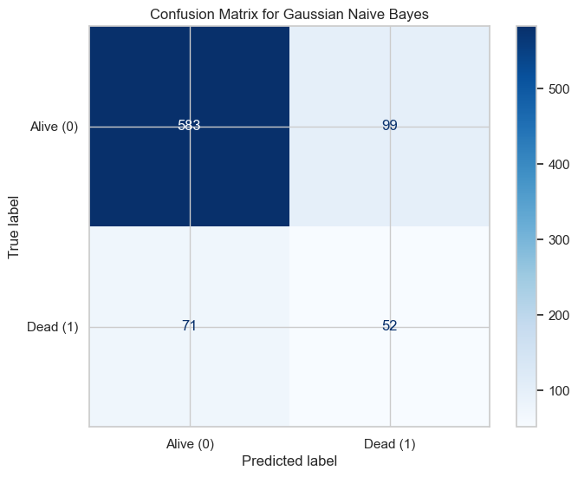
Model Results
Key Improvement:
  Baseline RF Recall: 14.63% → Tuned RF Recall: 44.72%
  3.06x improvement in identifying at-risk patients
  Trade-off: Accuracy slightly lower (79% vs 85%), but this prioritizes catching deaths
Best Hyperparameters Found:
  n_estimators: 100
  max_depth: 10
  min_samples_leaf: 4
  class_weight: 'balanced' ← Critical for handling class imbalance
Visual recommendations:
  Bar chart comparing Recall across models
  Confusion matrix for Tuned Random Forest
  Highlight the 3x improvement visually

Slide 20
Key Learnings & Next Steps
Key Takeaways:
Class imbalance is a critical challenge in medical datasets
Hyperparameter tuning with class balancing dramatically improves recall
Feature preprocessing (one-hot encoding) was essential
Tuned Random Forest provides solid foundation
Future Plans:
Advanced imbalance handling: SMOTE, ADASYN
Model refinement: XGBoost, LightGBM, advanced ensembles
Better evaluation: Precision-Recall AUC, cost-sensitive metrics
Model interpretability: SHAP values, feature importance
Goal: Achieve Recall > 50% for minority class

Slide 21
Conclusion
Summary:
Proper preprocessing + class balancing + hyperparameter tuning = significantly improved model
Recall improved from 15% to 44.7% (3x improvement)
Foundation set for further improvements
Next Steps:
Continue model refinement
Focus on interpretability for clinical use
Target: Recall > 50% in final deliverable

